Slide 1

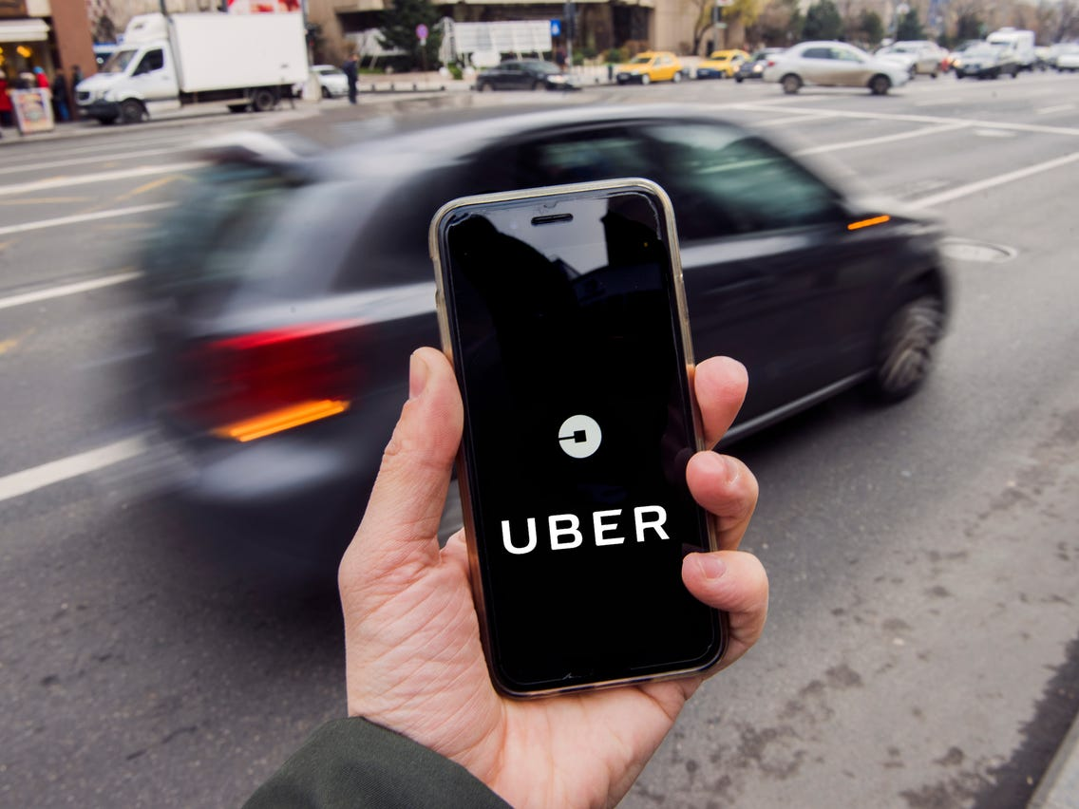

Slide 2
Company profile
Uber is a technology company.
Service started in March 2009.
It has a smartphone application that employs a GPS system to communicate between drivers and passengers.
The app allows the passengers to evaluate the drivers and drivers can also evaluate passengers.
The service is now available to over 250 cities around the world.
Notes:
The Company Profile
Uber is a technology company. It has a smartphone application that employs a GPS system to communicate between drivers and passengers who are closest to them. The passenger can evaluate the driver’s performance on every trip. The driver also evaluates the passengers on each trip. It helps passengers choose a well-rated driver to ride with him. The driver also plays his role in evaluating the passengers so that data are recorded in the future in case he is exposed to any legal issue.
The service began in March 2009 in the United States of America in San Francisco by Kalanick, the founder. Uber is rapidly growing, reaching more than 250 cities around the world. Among them are in the Middle East in Cairo, Dubai, Abu Dhabi, Riyadh, and Doha. The Uber application is available on all modern phone systems such as iPhone (IOS), Android system, and Windows system. Uber operates legally according to the laws of each country.

Slide 3
Organizational details purpose and structure
Uber is an application that allows people not to wait too much time for Taxi while they are resting or working.
It's a very large company that has been spreading all over the world since it began its tour by Kalanick from San Fransico U.S.A.
Uber is seeking to cover almost around the city to cover as many customers as possible for more profits and myriad of customers.
On the structure business model hand, Uber has main elements that describe its business structure.
Notes:
As we have mentioned above about Uber, Uber is a technology company through the Internet through smartphones. Uber is an application that allows people not to wait too much time for Taxi while they are resting or working, with an earlier 30 minutes, they can book their trip to wherever they go. Also, it's a very large company that has been spreading all over the world since it began its tour by Kalanick from San Fransico U.S.A.
In addition to its purposes, the company wants to provide the best case or condition for the customers. Uber is seeking to cover almost around the city to cover as many customers as possible for more profits and myriad of customers. Also, it presents a safe trip through very comfortable and convenient care with a decent driver. After a lot of technology companies have started their careers in the same idea, Uber had to put much effort and services to cover all customer purposes. However, company purposes are increasing over time.
On the structure business model hand, Uber has main elements that describe its business structure. A taxi driver is a person that has a car and a license can apply for Uber jobs in cities where the company covers. Passengers are those who booked the trip through their smartphones and calling for a car on the on-demand service by Uber. On the application nowadays, they can see any of the driver's information, the fare, the distance, the track of the taxi driver on GPS, etc. Also, the Uber business model provides the fare of the ride before booking to let the customer decide if okay or not. Besides, they offer a lot of payment methods via credit cards or cash at the end of the journey.

Slide 4
Competitive strategies
Reducing costs and providing distinctive services.
  Cost leadership strategy-lowering cost while maintaining an acceptable level of quality.
  Differentiation strategy-focus on differentiation of products.
  Focus strategy-focus on certain units of product
Notes:
#1.Cost leadership strategy. In this strategy, the firm surely has to lower the cost of the product with sustaining an acceptable level of quality in the products for customers' demands.
#2. Differentiation strategy. In this strategy, the drivers are the differentiation when the product itself is able to market itself or sells itself. That's what Differentiation means, and that's why companies need to do to differentiate their products and services better than their competitors.
#3.Focus strategy. In this strategy, the firm focuses and targets a particular unit of products and that segment is offered at lower prices and higher quality. This such strategy is very useful and helpful for entering a new market to attract and grab a lot of customers through high quality + low prices.

Slide 5
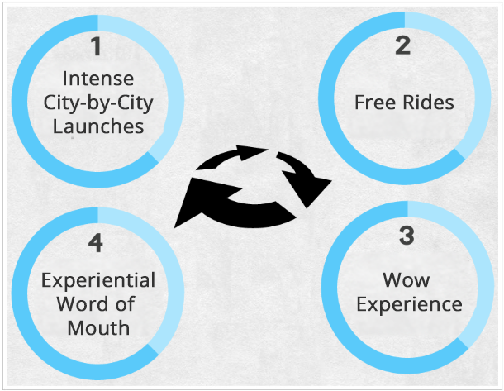

Slide 6
Performance Strategies for Uber
The Initiative. The average person considers the focus strategy while the outstanding person considers it the cost leadership strategy.
See the full Vision. The Company seeks to crystallize practical practices within clear mental frameworks and images. They even sacrifice their lives in order to learn the important visions of others.
Leadership Skills. Anyone's leadership skills do not mean more than the ability to impose opinion and control others, and the keenness to display this ability and be proud of it whenever the opportunity arises
Team Spirit.
Customer Service(Passengers).
Notes:
The Initiative. The average person considers it my last strategy. While the outstanding person considers it the first strategy. It boils down to initiate a specific action in a more efficient and faster manner.
The initiative also occupies the first place of strategies, as it is the first thing that those around you watch when you join them, as you are the focus of everyone's attention to see your ambitions.
#2-See the full Vision. The average person thinks that this strategy means as sequence of events and repeating it in front of the higher management to obtain the necessary support and credibility to express opinion and advice and vote on the decisions of the higher councils. As for the distinguished, The Company seeks to crystallize practical practices within clear mental frameworks and images. They even sacrifice their lives in order to learn the important visions of others. They do this with a view to understand the relationship between their work and the greater team effort.
#3-Leadership Skills. Anyone's leadership skills do not mean more than the ability to impose opinion and control others, and the keenness to display this ability and be proud of it whenever the opportunity arises. As for the distinguished, he works as an authority less leader, calmly and without showing. Young leaders usually do not have direct control over anyone, nor do people who depend on their wages in spending their wages. Fellows voluntarily collaborate with junior leaders, under the influence of their leadership skills rather than their showmanship.
#4-Team Spirit. The company suffices from this strategy that falls under the banner of one of the work teams and does only what is required of it. Percentages are much better, however, between high performing organizations and those in line with performance management and business goals. Uber has to understand the importance of feedback on the driver of continuous improvement and has found a way to achieve this.
#5-Customer Service(Passengers). You have to watch out all the trips of the passengers and how far they are satisfied with the service and what were the negative points to avoid or to fix, etc. Also, a very fast answer to the customers must be available in Uber service in case of any problem or asking for help.

Slide 7
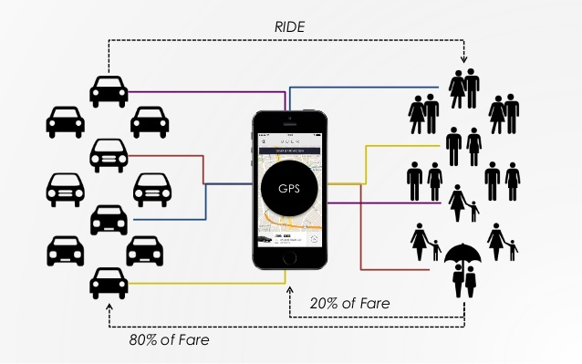

Slide 8
Performance strategies
#4-Team Spirit. The company suffices from this strategy that falls under the banner of one of the work teams and does only what is required of it. Percentages are much better, however, between high performing organizations and those in line with performance management and business goals. Uber has to understand the importance of feedback on the driver of continuous improvement and has found a way to achieve this.
#5-Customer Service(Passengers). You have to watch out all the trips of the passengers and how far they are satisfied with the service and what were the negative points to avoid or to fix, etc. Also, a very fast answer to the customers must be available in Uber service in case of any problem or asking for help.
Notes:
#4-Team Spirit. The company suffices from this strategy that falls under the banner of one of the work teams and does only what is required of it. Percentages are much better, however, between high performing organizations and those in line with performance management and business goals. Uber has to understand the importance of feedback on the driver of continuous improvement and has found a way to achieve this.
#5-Customer Service(Passengers). You have to watch out all the trips of the passengers and how far they are satisfied with the service and what were the negative points to avoid or to fix, etc. Also, a very fast answer to the customers must be available in Uber service in case of any problem or asking for help.

Slide 9
Technology involved
The capacity of the It infrastructure components is around Software, Hardware, Storage, and Network.
Software, cloud capacity helps the business to upload and save customer database.
there are a lot of software tools that help you predict how the load is your network in each area.
Notes:
Uber has a very good IT infrastructure to manage its business path successfully. However, IT infrastructure, as being known, is about providing resources to meet the business requirements to satisfy the customers' requirements. The capacity of the It infrastructure components is around Software, Hardware, Storage, and Network. Also, the objective of it is not to provide a way to aggregate some capacity but to get this capacity connected or attached to a specific demand. For Software, cloud capacity helps the business to upload and save customer database, and over time, as the cloud is growing up a lot, it is increasingly about providing just-in-time delivery of that capacity. On continuing the compute and storage side, Uber has later solved this problem with a big part of the challenge through the Virtualization chance. As Virtualization works on freeing up all of the software resources, all application that has a connection towards these resources can easily be satisfied as-needed through application portability.

Slide 10
Existing system
Key problems
  Cash Burn: Uber has spent so much money through burning cash to cover billions $ of losses for the sake of building a market share and attract as many customers as possible.
  Low unemployment rate: In the past, the company wasn't concerned at all about employing rate or attracting drivers since unemployment was still as a result of the Great Recession.
Notes:
Although Uber is one of the pioneer companies in the industry, it has faced lots of problems in its system.
1. Cash Burn: Uber has spent so much money through burning cash to cover billions $ of losses for the sake of building a market share and attract as many customers as possible. Cash was burnt by paying-out and in rider discounts and offers. It pays more money than it brings in. Since the Wall Street Journal recently published news comparing companies in the idea of taking losses to hold the market share on, Uber was in the top list in a matter of eight years of growing. Not only Uber was more than Amazon in revenue, but also it was much more in operating losses.
2. Low unemployment rate: In the past, the company wasn't concerned at all about employing rate or attracting drivers since unemployment was still as a result of the Great Recession. Besides, service companies tend to have a high turnover of employees as a sort of fast food or Retail Company. Over time, Uber may have fear the full-employment, which can cause it very critical trouble in attracting drivers even though in smaller markets.
3. No clear path to profitability: Over time, the corporate has been cut drivers payment by half, but they are acceptable not so bad due to the low unemployment rate. Also, the firm may not be able to raise it once again incrementally. However, the corporation is hoping now, before running out of money, to lie their business path in driverless cars, and thus they can go on obtaining their profitability so well.

Slide 11
Uber Information Systems
Transaction Processes System (TPS): It's a very meaningful system because it provides Uber very good information about the system.
In ERP, Uber uses SAP software to enhance the experience of uber users.
In DSS, Uber uses this technology to make better decisions for customers to enhance the experience of the service.
Intelligent business, the company uses this technology to enable the customers to access the service and their location so that they can get wherever they want fast

Slide 12
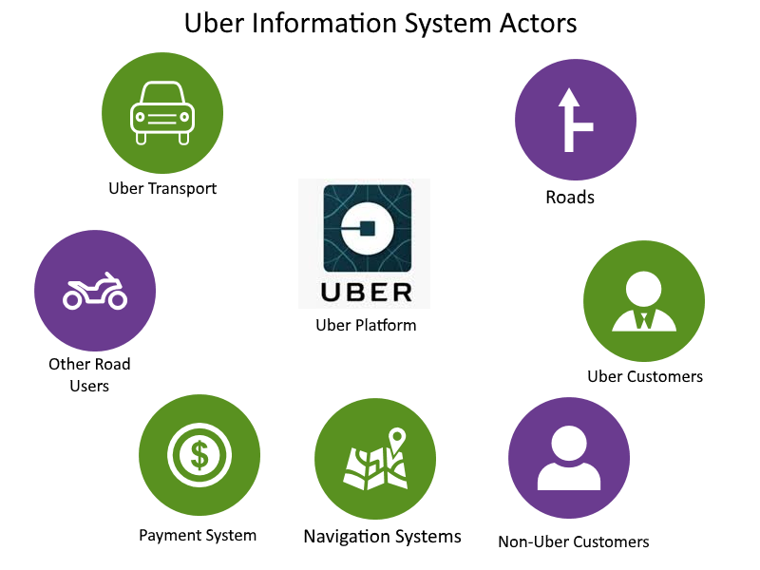

Slide 13
Recommendations
Uber should exert much effort to fix small things like the low unemployment rate problem.
the company should lie in the most information system to improve its business operations more and more through collecting database for lots of customers.
it should think better in getting profits at low losses because coverage losses are not a smart way to grow up fast
Notes:
According to the report above of all the information systems and the key problems of its existing system, Uber should exert much effort to fix small things like the low unemployment rate problem. Thus, it can cause a very run-away of most drivers to another country or another business career due to an unacceptable salary.
Also, the company should lie in the most information system to improve its business operations more and more through collecting database for lots of customers and attract them with the marketing methods or attractive customer’s strategies. Although Uber is an integrated company, it should think better in getting profits at low losses because coverage losses are not a smart way to grow up fast. To sum up, Uber has to put much effort into safety policy to help customers enjoy the journey in a safe mood without any fears.

Slide 14
Conclusion
The company needs to adapt to MIS to enhance its business operations and processes plus the experience of the customers.
Information systems are the best way to go on with because it can help the management of uber processes to access all required information on time.
Uber should take part in online analytical processing, data mining, querying, and reporting, and thus Uber operations will ease decision-making processes, identifying new opportunities for business, and efficient cost management.

Slide 15
References
Blystone, D. (2020, August 28). The Story of Uber. https://www.investopedia.com/articles/personal-finance/111015/story-uber.asp.
Bushong, M. (2014, May 1). On Uber and IT Infrastructure - DZone Java. dzone.com. https://dzone.com/articles/uber-and-it-infrastructure.
Farooq, U. (2020, March 2). What is Competitive Strategy - Definition, Types &amp; Examples. Marketing Tutor. https://www.marketingtutor.net/what-is-competitive-strategy/.
Hsinchun, C., Chiang, R. L., & Storey, V. C. (2012). Business intelligence and analytics: from big data to big impact. MIS Quarterly, 36(4), 1165-1188.
Key Problems and challenges faced by Uber. Retrieved October 27, 2020, from https://www.bizjournals.com/chicago/news/2019/05/22/uber-faces-serious-challenges-in-the-future.html
Leadership Development &amp; Executive Coaching. Performance Strategies. (2020, June 29). https://perform.com.au/.
Member, F. (2018, February 25). How Can SAP Make Uber Better? Retrieved October 27, 2020, from https://blogs.sap.com/2018/02/25/how-can-sap-make-uber-better/
Thapa, S. (2018, April 6). Analysis of Business Structure of Uber. IPleaders. https://blog.ipleaders.in/business-structure-of-uber/.

